Slide 1
Intel Maker’s ESP32 course – by intel’s makers community class 1.1 – I/Os Lab
Gil Tal.
Jun 2021

Slide 3
Class 1.1 agenda:
Basics (very basics) electronics – Basic electrical circuit
Ohm law
Digital in\out
Analog in\out

Slide 4
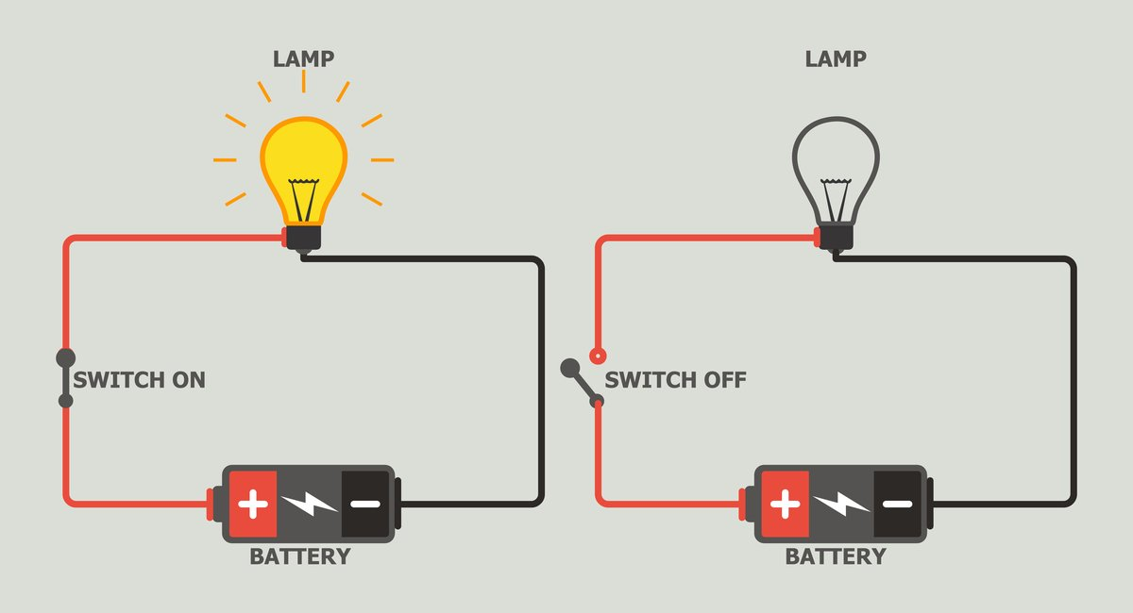
Basic electrical circuit
Basically, we need a power source, which can be a battery for example
We need a consumer – Lamp for example
Once we connect the circuit – current will start flowing and in our example the lamp will start lighting

Slide 5
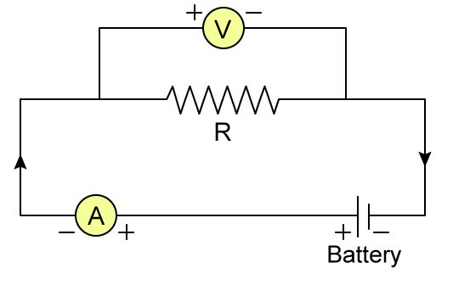
OHM law
V = R*I (URI)
R – represents our consumer
Circled V is a voltmeter – which measures the level of voltage on the consumer R
Circled A is an ampere-meter – which measures the amount of current in flowing in the circuit

Slide 6
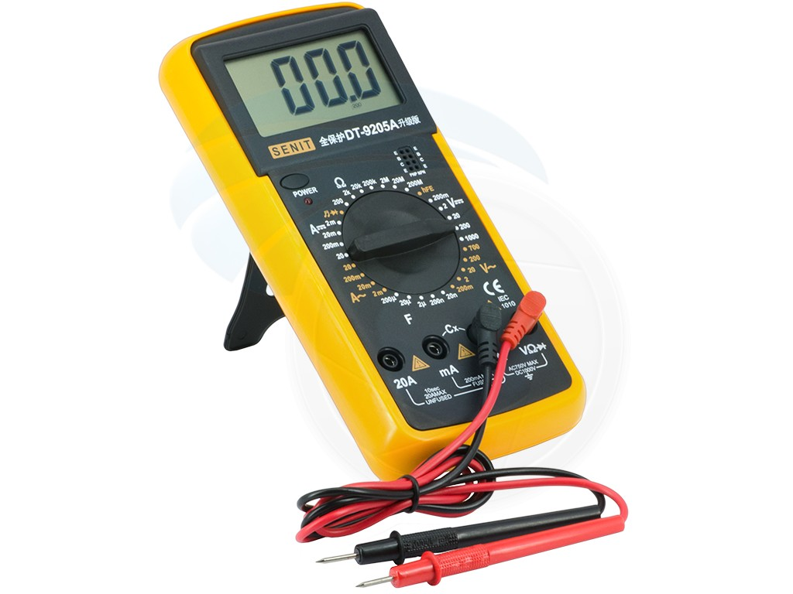
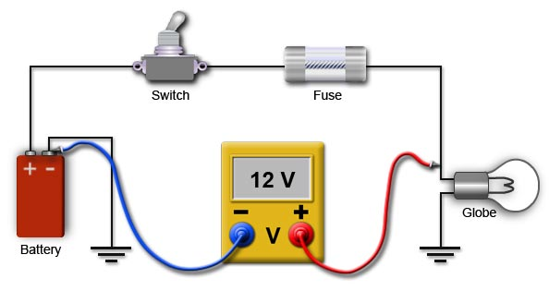
Simple voltmeter
12V

Slide 7
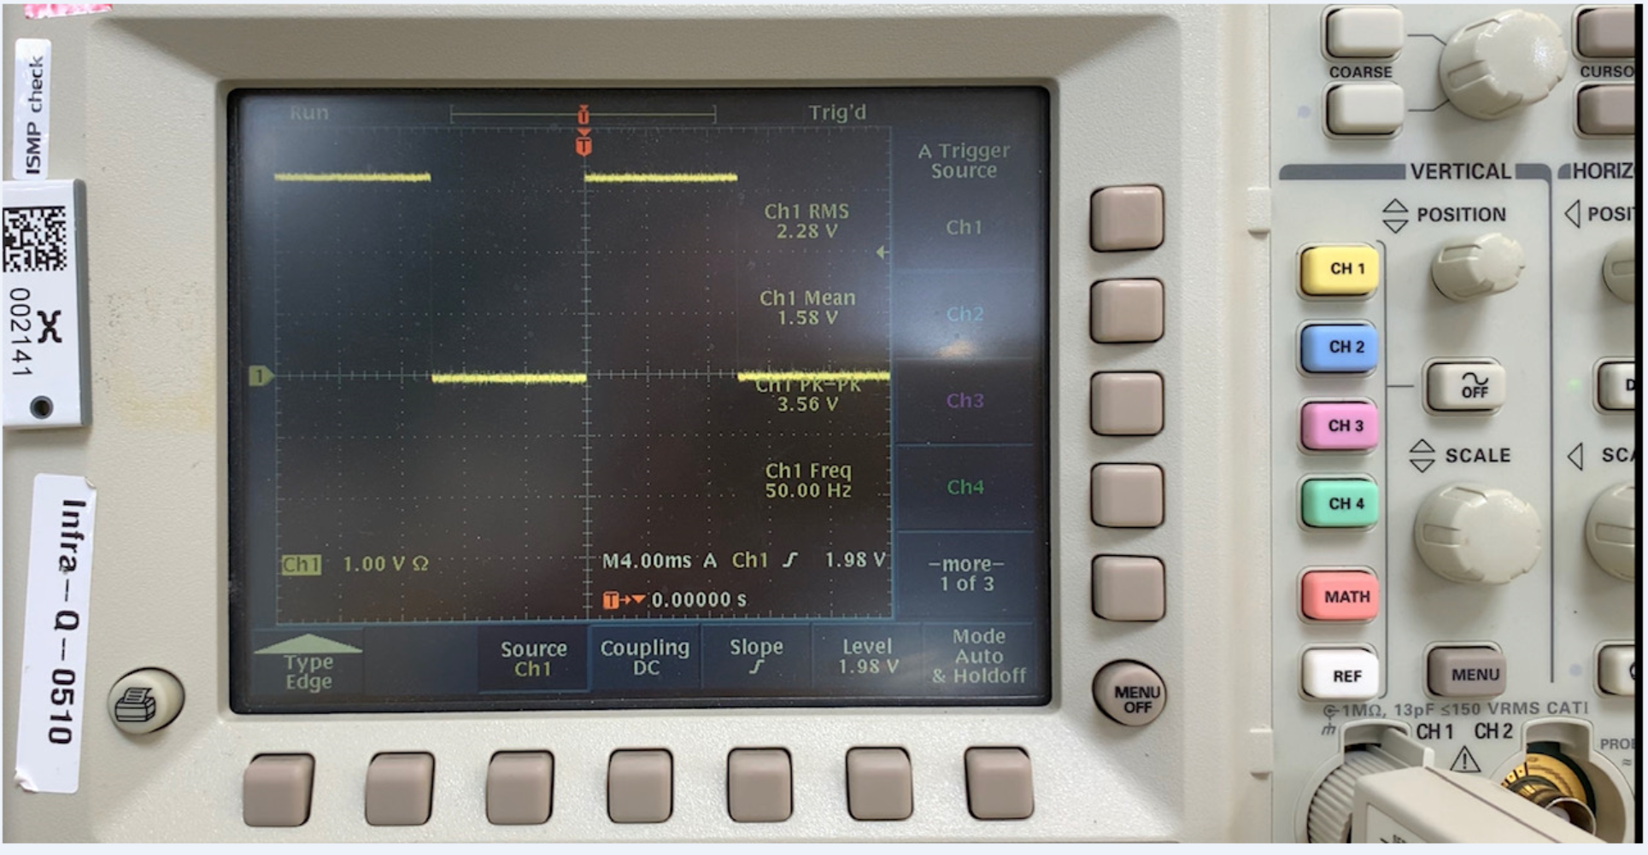
Advanced voltmeter - Scope
Measures the voltage level and display it on a screen constantly
Has advanced features for:
Measure frequency
Triger on event
And more…

Slide 8
Digital In/Out

Slide 9
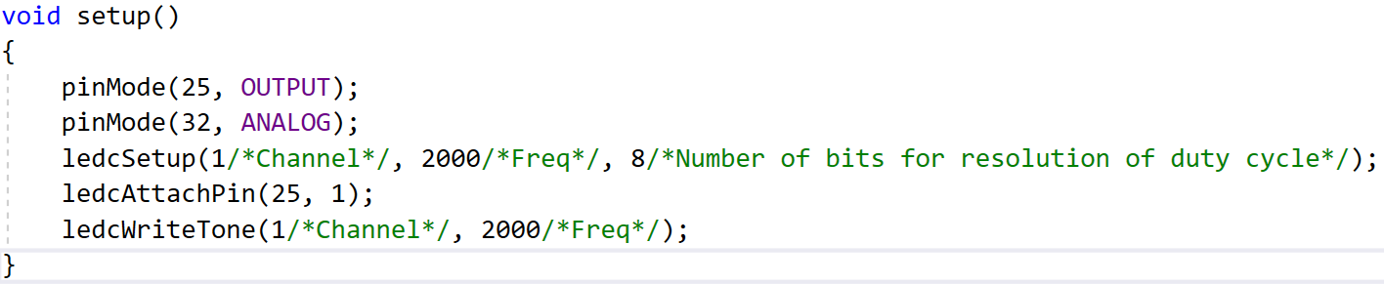
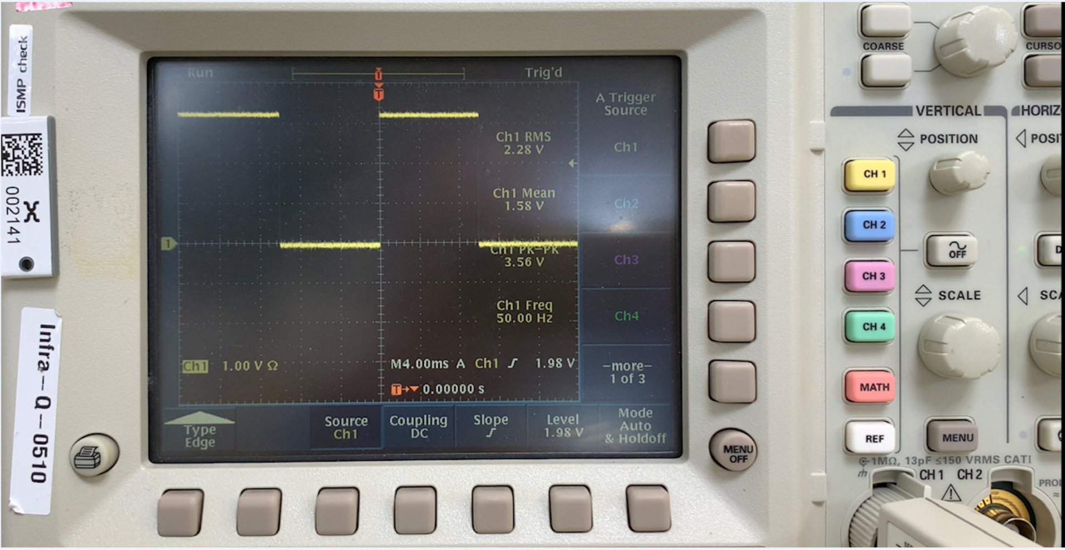
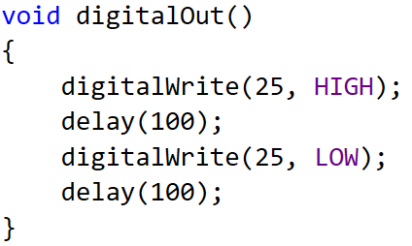
Digital OUT on the Scope

Slide 10
Analog Input\Output

Slide 11
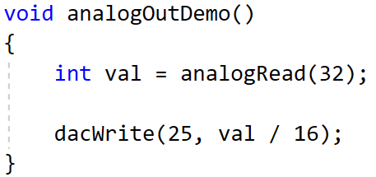
Analog In/Out

Slide 12
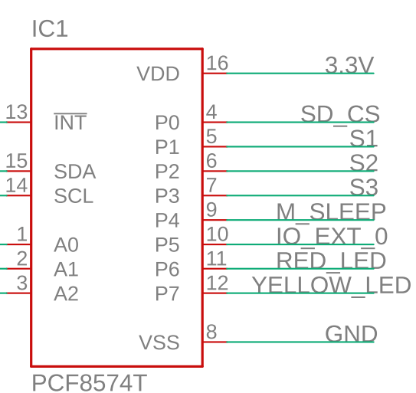
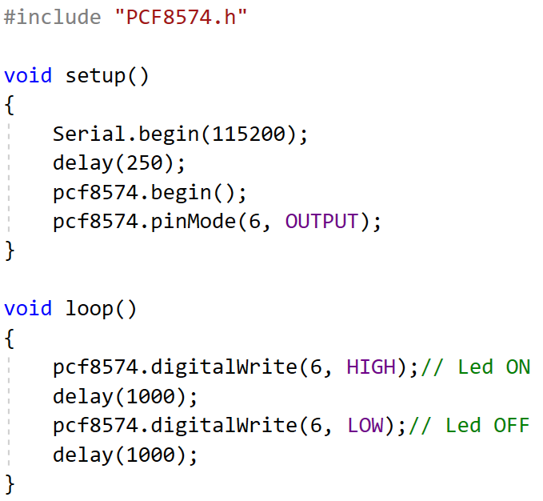
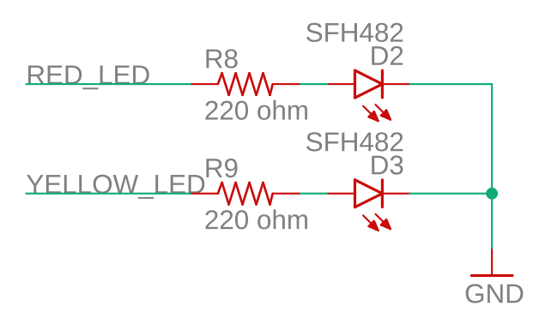
Let's turn on the LED of our platform
Two LEDs are connected to the I/O expander
Red Led connected to I/O 6
Code:

Slide 13
PWM - Pulse-width modulation
Enable us to generate a square waveform from basically 0 – 65KHz
We can control the duty cycle of the generated waveform
Can be used to:
Generate music ☺
Control the luminance of a LED matrix
Control the speed of a DC motor

Slide 14
Communication between two devices
This way we start communicating….
From basic messages to complex protocols
Many I/Os can used
I2C, UART and SPI are common and simple examples

Slide 15
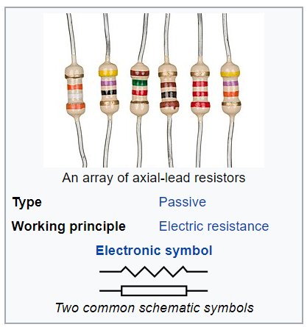
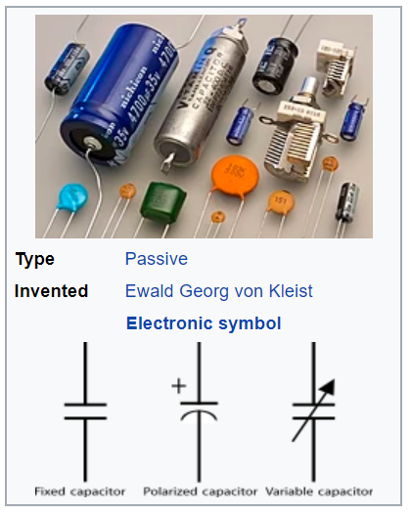
Basic components
A resistor is a passive two-terminal electrical component that implements electrical resistance as a circuit element.
Basically turns electrical energy into heat.
Measure unit: ohm
Usages: Limit current, drop voltage level, Pull up/down floating signals
A capacitor is a device that stores electrical energy in an electric field. It is a passive electronic component with two terminals.
Measure unit: Farad
Usages: Handle power supply surge, very fast absorption of electrical energy (also fast discharge), along with a resistor a simple reset at power on

Slide 16
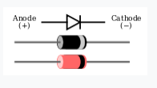
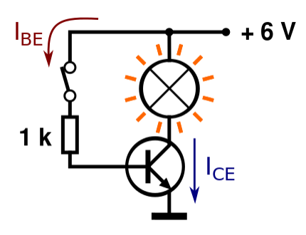
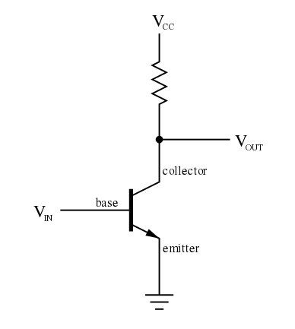
A diode is a two-terminal electronic component that conducts current primarily in one direction (asymmetric conductance); it has low (ideally zero) resistance in one direction, and high (ideally infinite) resistance in the other.
A transistor is a semiconductor device used to amplify or switch electronic signals and electrical power

Slide 17
Complete LED Circuit

